Slide 1





Polygenic Disease Association risk, variation, and machine learning
Dr Panagiotis Alexiou, PhD
ERA Chair: Bioinformatics for Genomics in Malta
panagiotis.alexiou@um.edu.mt

Slide 2
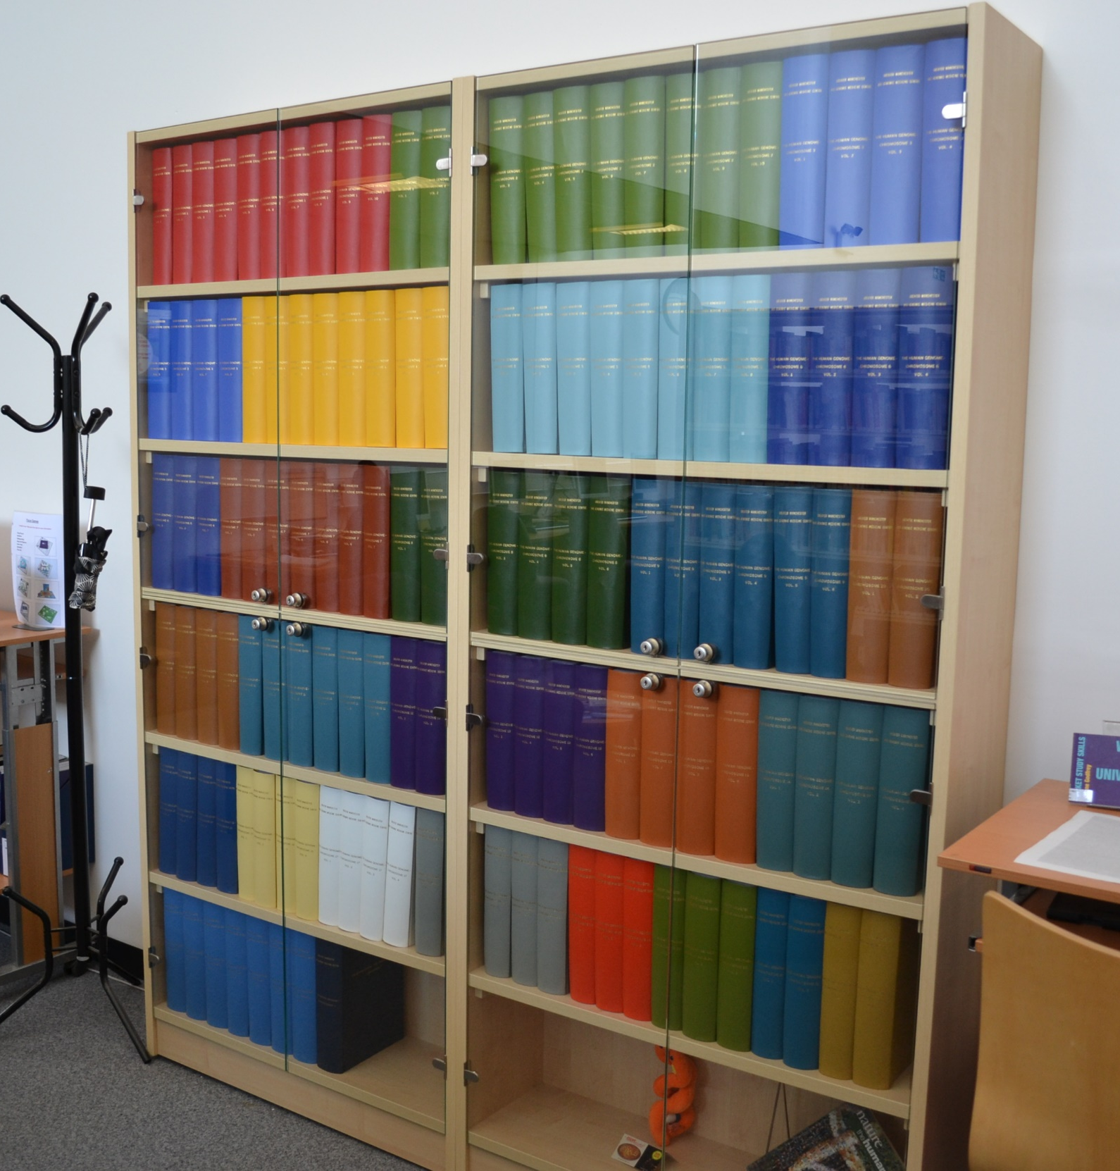
The Genome as a Library
~3 billion letters in 23 chromosomes
Each chromosome has a double copy
Parts can be read L>R and others L<R

Slide 3
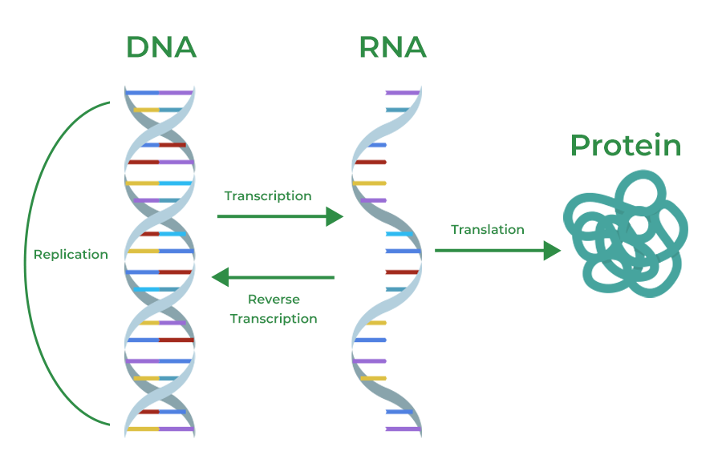
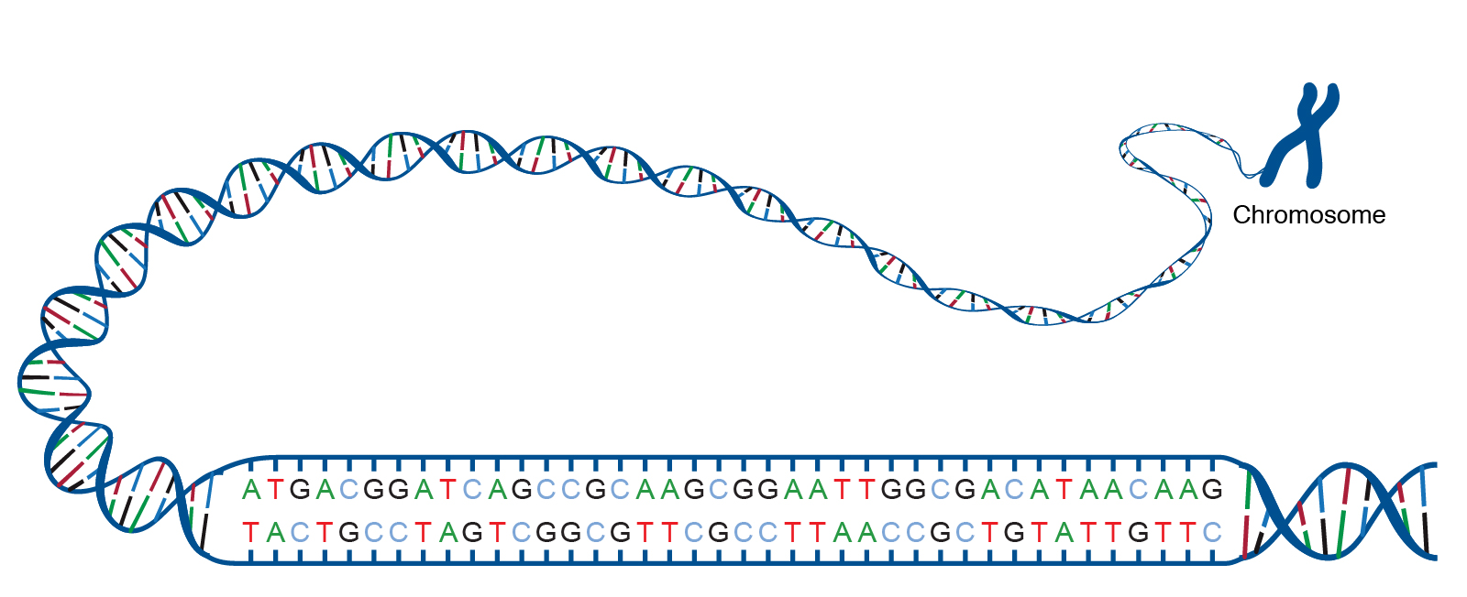
Each Gene encodes a Function
4 Letter Alphabet (A, C, G, T)
Genes encode messages (RNA)
RNA can function by itself or produce Proteins
RNAs and Proteins are the bricks and machinery of the cell
~1% of the Genome is Genes

Slide 4
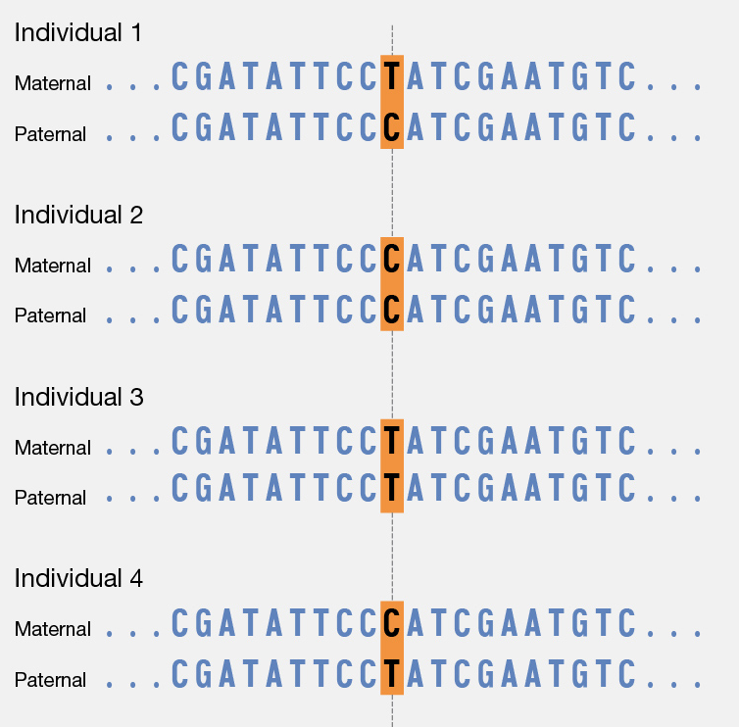
Each person has a different Genome
(Variation)
~3 billion letters in 23 chromosomes
Each chromosome has a double copy
Each person has ~1-2 thousand variants compared to the ‘standard’ genome
~1% of the Genome is Genes
Most variants make no real difference

Slide 5
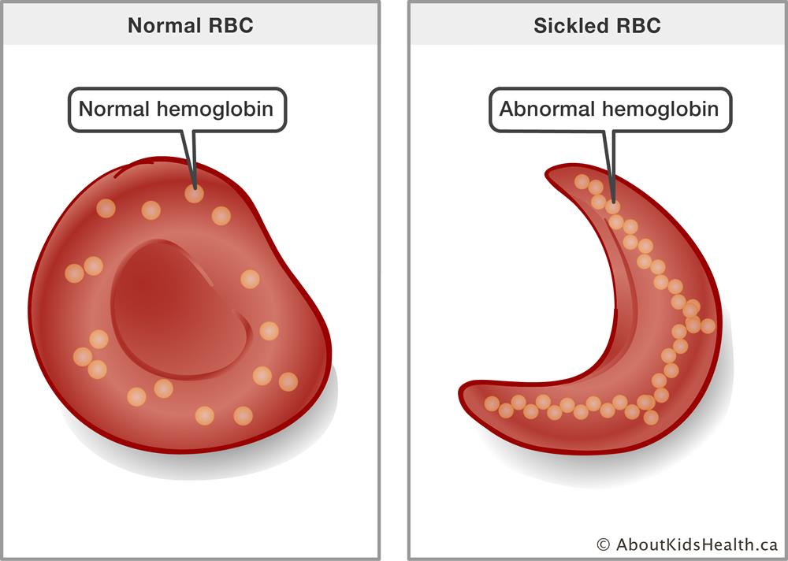
Monogenic Traits
(e.g. sickle cell anaemia)
A single variation in one letter of the gene encoding Hemoglobin produces deformed Red Blood Cells and leads to sickle cell anaemia
Mono – genic
(Single) – (Gene)

Slide 6

Polygenic Traits
(e.g. height)
Biological
Pathways

Slide 7
Polygenic Traits
There are usually many mechanisms that can lead to the same endpoint: e.g. there is not a ‘cancer’
There are more mechanisms that we don’t know about
Effects can happen over decades and in various cells and tissues – hard to model or monitor
All cells have copies of the same Genome!

Slide 8
Genotype
Whole Genome Sequencing:
a measurement of each letter at each position (2x)
Exome Sequencing:
a measurement of each letter on mRNAs (2x)
Genotype Panel:
a measurement of specific positions (2x)

Slide 9
Genotype
At position chr3:1553 this individual has a A|A genotype. The reference genome has an A. The individual is homozygote
At position chr3:1553 this individual has a A|C genotype. The reference genome has an A. The individual is heterozygote
At position chr3:1553 this individual has a C|C genotype. The reference genome has an A. The individual is homozygote alt
homozygote
heterozygote
homozygote alt
Allele 1
A
A
G
A
G
G
Allele 2
A
A
A
reference

Slide 10
alt
alt
GENE A
GENE B

Slide 11

alt
alt
GENE A
GENE B
X
X
X
X
X
X
X
X
X
X

Slide 12
Produce a Score based on Variants to classify samples
X
X
X
X
X
X
X
X
X
X

Slide 13
Produce a Score based on Variants to classify samples
X
X
X
X
X
X
X
X
X
X
Issues
Sampling: expensive, difficult to standardize, large variability and batch effects
Features: 100,000s of variants of known biomedical effect / millions of variants total (to classify 100s of samples)
Variability of Disease: People get the same condition for different reasons (i.e. we don’t know the subclasses)

Slide 14
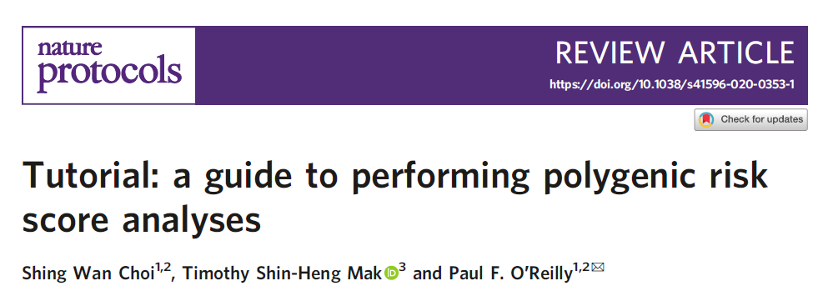
A polygenic risk score (PRS) is an estimate of an individual’s genetic liability to a trait or disease, calculated according to their genotype profile and relevant genome-wide association study (GWAS) data.

Slide 15
PRS is an estimate of an individual’s genetic liability to a trait or disease,
calculated according to their:
1. genotype profile and
2. relevant genome-wide association study (GWAS)

Slide 16
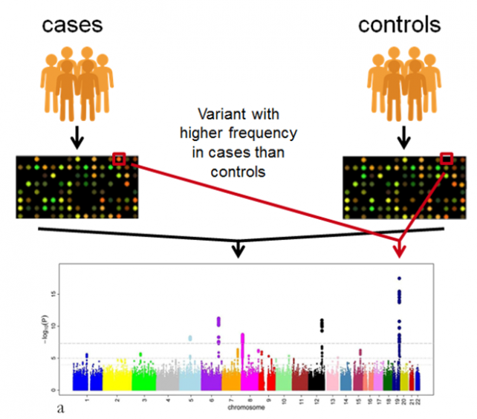
GWAS
Genome
Wide Association Studies
Identify variants in a population that often associate / correlate with the trait of interest.

Slide 17
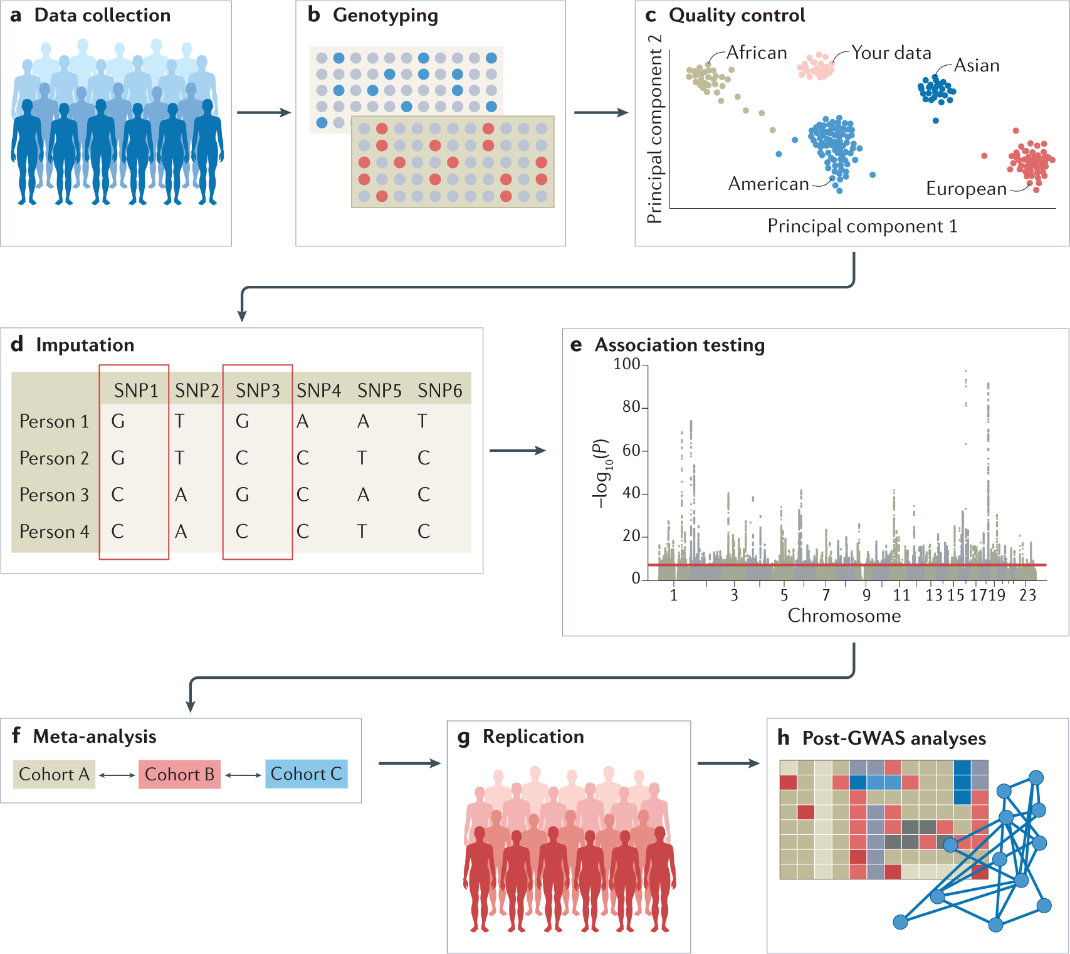
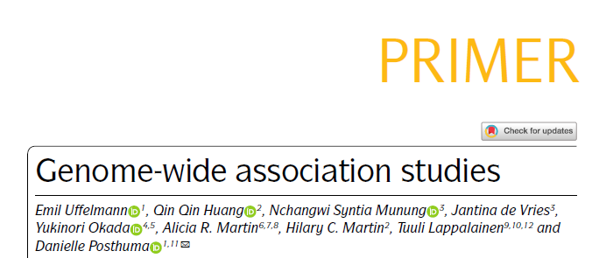

Slide 18
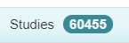
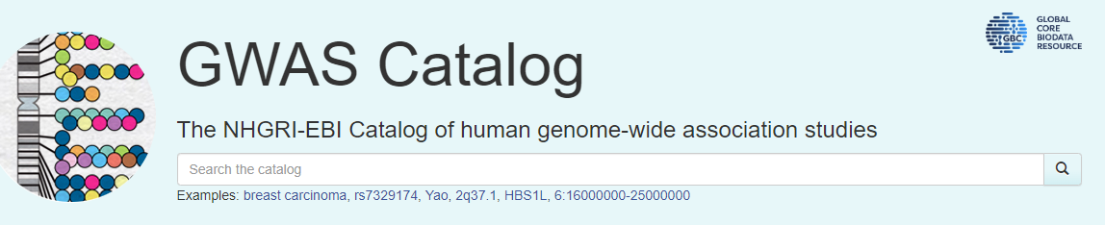
Genome
Wide Association Studies
Correlation =/= Causation
Correlation =/= Predictive Power

Slide 19
The use of summary statistic data for the genotype effect size estimates distinguishes polygenic scores from phenotypic prediction approaches that exploit individual-level data only.
In the latter, genotype effect sizes are usually estimated in joint models of multiple variants and prediction performed simultaneously, using approaches such as best linear unbiased prediction21,22 or least absolute shrinkage and selection operator (LASSO)23,24
data sharing restrictions limit full access to individual-level data;
heterogeneity across cohorts reduces the motivation to pool individual-level data
population cohorts generally have relatively few individuals with specific diseases
Base data
(GWAS)
summary statistics of genotype-phenotype associations typically made available online in text format
Target data (genotype/phenotype)
individuals from a sample to which the researchers have access

Slide 20
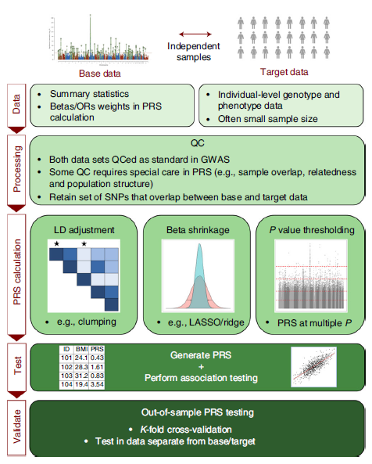

Slide 21

0.9
Linkage Disequilibrium (LD) = Independence of variants
Clumping: picking the ‘best’ variant at each cluster
‘best’ = correlates the most with the condition
---
Other better methods (e.g. based on Bayesian statistics) are being developed.

Slide 22
0.9
0.65
0.7
Scaling (shrinkage) of scores to bring them into closer scale to each other.
Known to increase predictive power.

Slide 23
0.9
0.65
0.7
Only select values above a certain p-value significance threshold
> In order to reduce the number of measured variables

Slide 24
In calculating PRSs on a binary (e.g., case/control) phenotype,
the effect sizes used as weights are typically reported as log
Odds Ratios (log(ORs)).
PRS values are computed in relation to a hypothetical individual with the non-effect allele at every SNP, and, thus, they provide only a relative (compared to other individuals) estimate of risk (or trait effect) rather than an absolute estimate.
Typically PRS calculation involves a simple summation of effects.
--------
Regression against Target Data > how well does PRS perform?
When covariates are included in the model, then measures such as the incremental R² (increase in R² with the addition of the PRS to the model), which isolate the explanatory power of the PRS, should be reported.

Slide 25
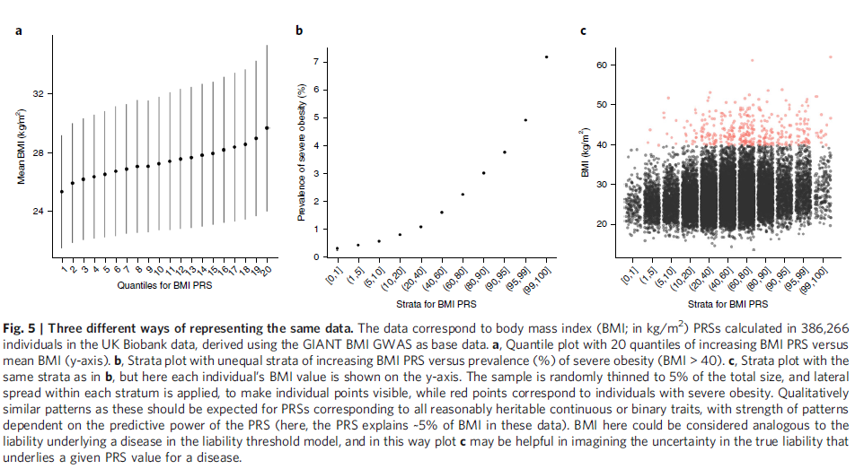

Slide 26
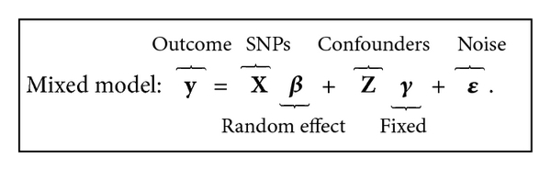
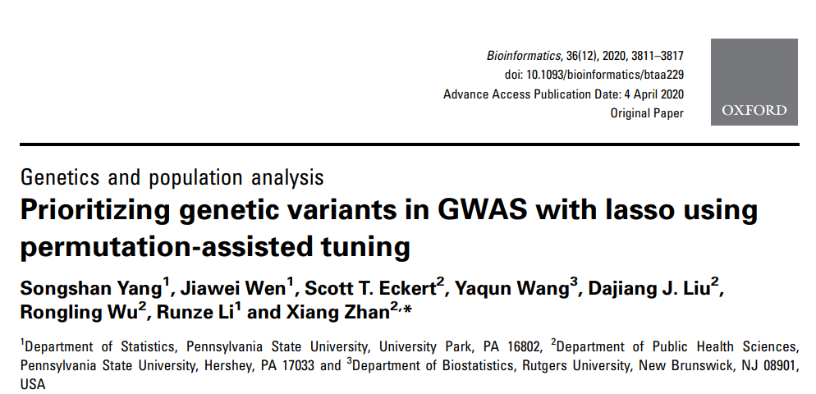
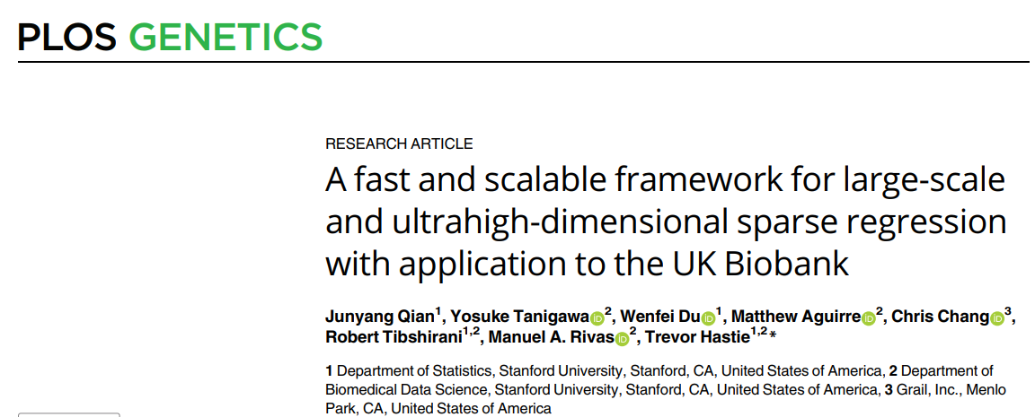
In high-dimensional regression problems, we have a large number of predictors, and it is likely that only a subset of them have a relationship with the response and will be useful for prediction. (…) The lasso is a widely used and effective method for simultaneous estimation and variable selection.
(Qian et al, 2020)
LASSO Regression: can BOTH estimate and remove SNPs/variables
HOW to tune λ

Slide 27
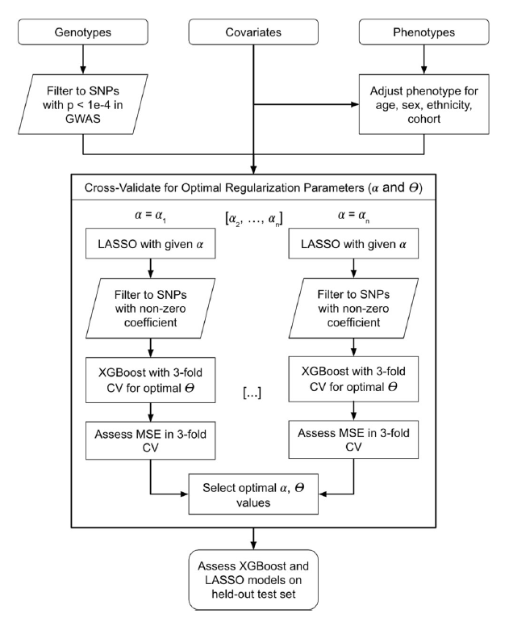
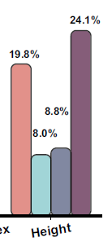
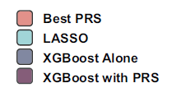
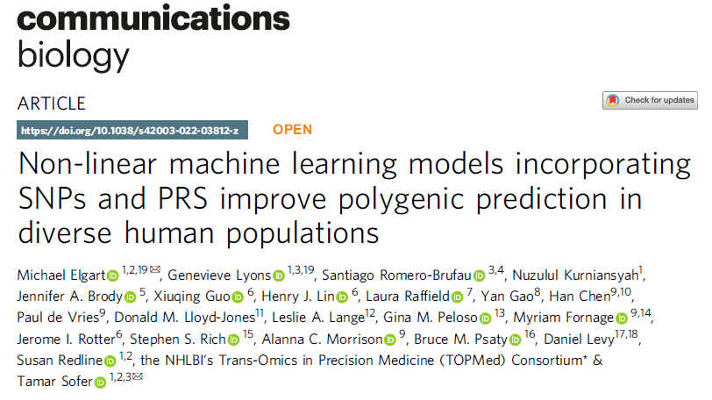
Elgart et al. 2022

Slide 28
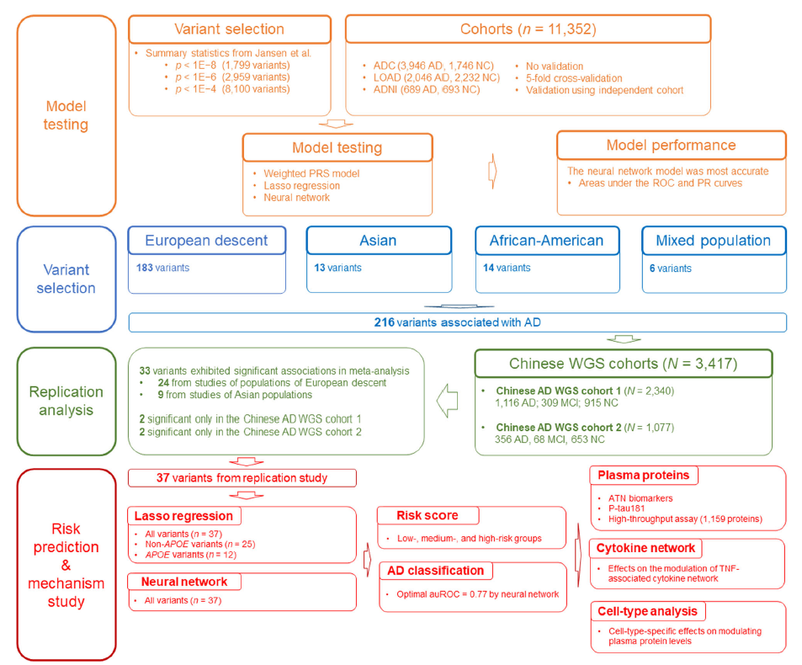
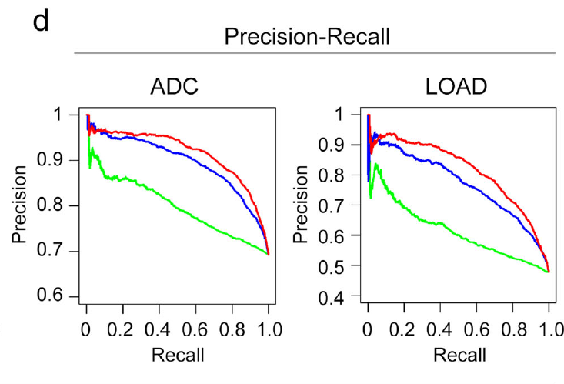
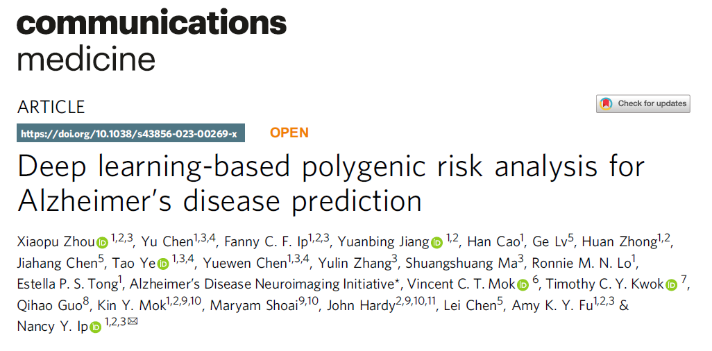
Zhou et al. 2023

Slide 29
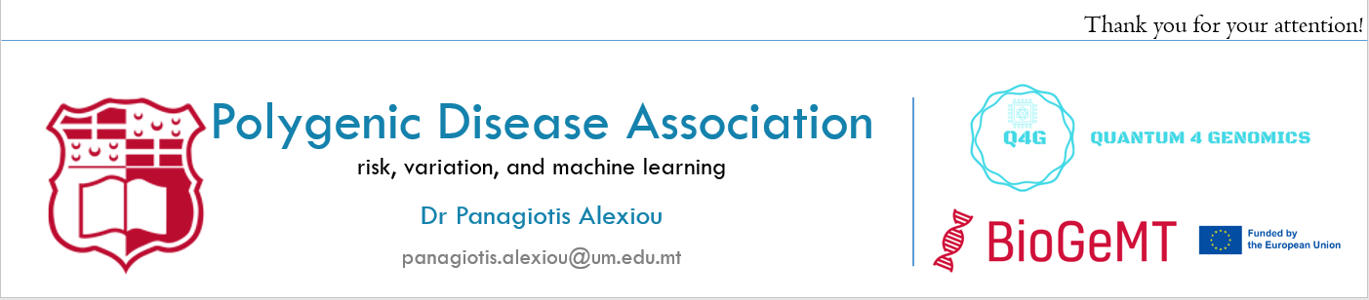
The Future
More data (million+ genome project, US genome project etc)
More isolated small datasets / cohorts on specific issues
More regulations and legal difficulties with sharing data
Great potential for medical breakthrough

Slide 30
Polygenic Disease Association risk, variation, and machine learning
Thank you for your attention!
Dr Panagiotis Alexiou
panagiotis.alexiou@um.edu.mt

